Slide 1
Dating App System
www.vibing.com

Slide 2

BACKGROUND
History of Love and Technology begins in 1994
with the first modern dating app KISS.COM
#2 Online dating is now the second-most-common
way for partners to meet
“We are not trying to take love out of love. We are just trying to make it more efficient” - Jeff Tar in 1966

Slide 3

WHO ARE WE?
The process is simple.
All you have to do is register and
we will connect you with your perfect
match in O(n^3) time!
Vibing.com is an online dating platform
Our algorithms are designed to determine the most suitable match for YOU, if
he/she exists

Slide 4

Objectives
Our main objective is to find the best match for each user, based on the score
The system deploys the STABLE
MATCHING algorithm, subjected to the predefined set of personal information provided by you.
Your privacy is of a GREAT importance for us, and we assure you that your information will remain safe.

Slide 5
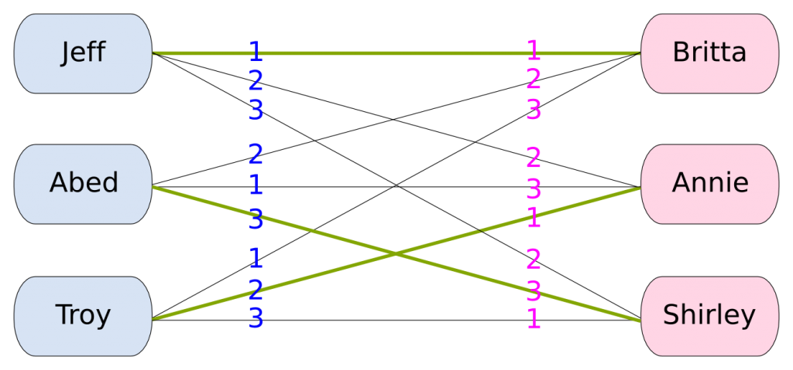
Stable Matching Algorithm
Stable Marriage
problem in a nutshell

Slide 6
Project Planning

Slide 7
TEAM ORGANIZATION
01
02
03
LUKA MODERC
PHUDIS DAWIEANG
ANDELA BASIC
Project manager
Programmer
Assistant Project Manager
04
06
05
UROS CVIJANOVIC
JEFFERS CHAN
BALAJI VARUN ADITYA
Testing Engineer
Testing Engineer
Programmer

Slide 8
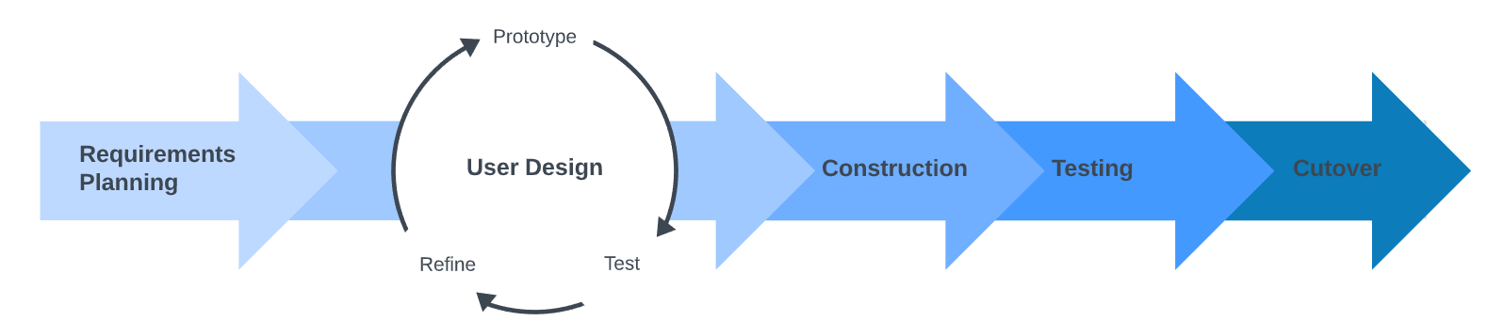
SOFTWARE DEVELOPMENT METHODOLOGY
Careful examination of our team and objectives resulted in choosing the RAPID APPLICATION DEVELOPMENT as our project management strategy.
Originally, it consists of 4 phases:
requirements planning, user design, construction and cutover. However,
we decided to emphasize the testing process and debugging process so we separated it into the 3 cycles

Slide 9
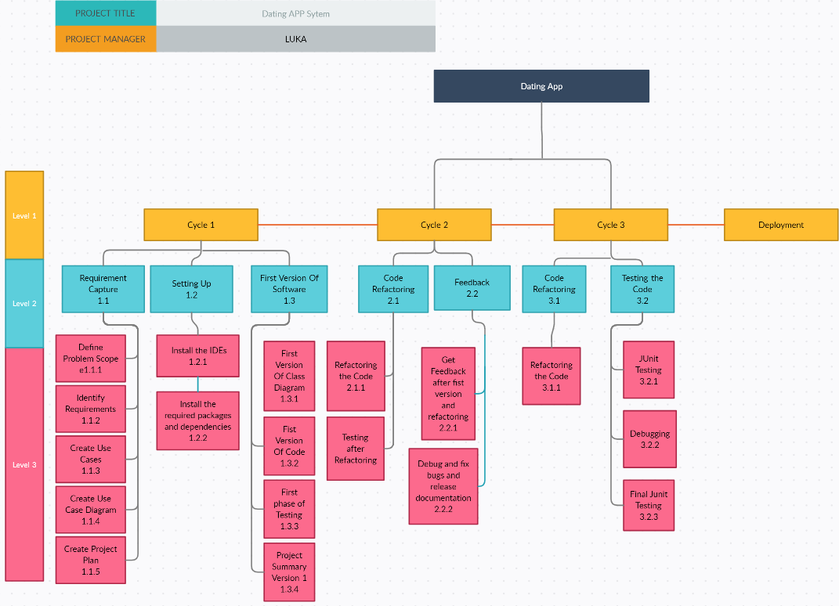
WORK BREAKDOWN STRUCTURE

Slide 10
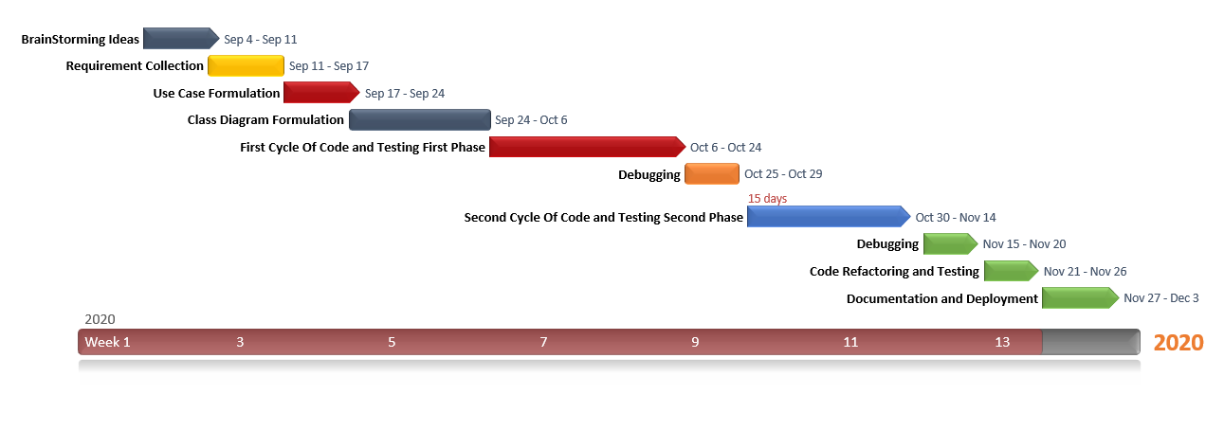
Gantt Diagram

Slide 11
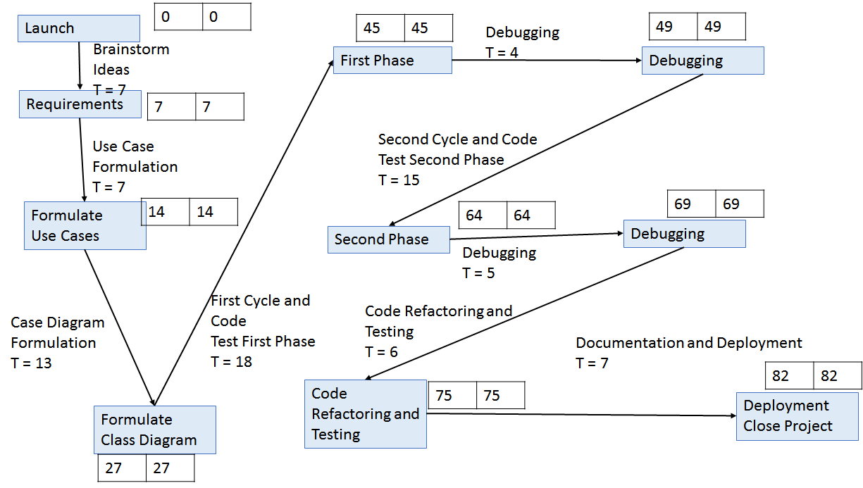
Activity Network

Slide 12
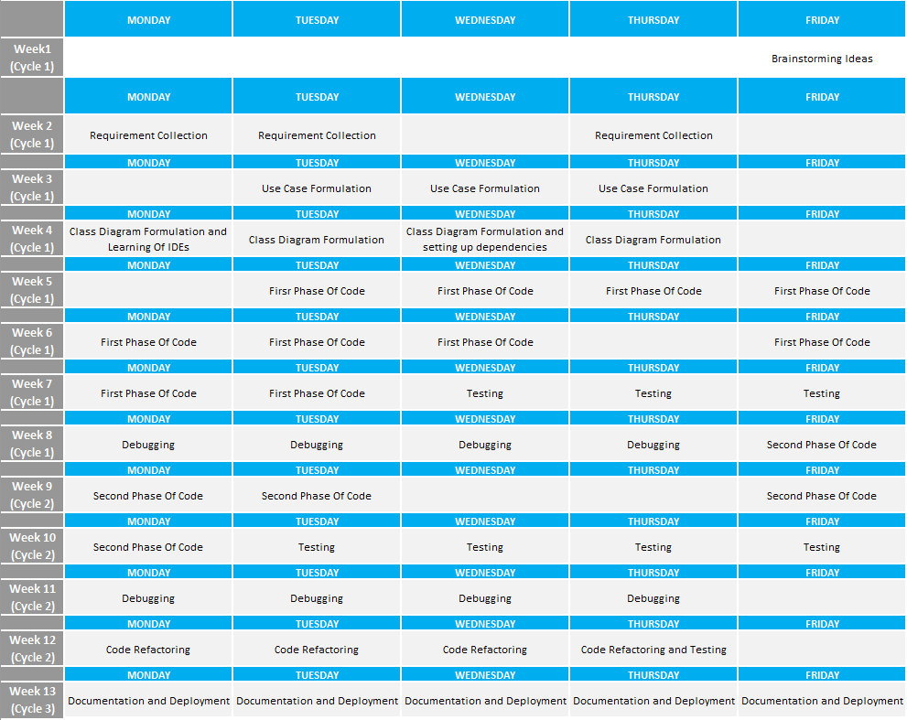

Slide 13
Resources Assignment
Breakdown of the workload among our team members requires detailed approach, as the work shall be allocated according to one’s capabilities
The job schedule was followed, and constant progress evaluation was made.
Recalculating and rescheduling is done if we go out of schedule, with keeping the project development in pace.
Resources are limited.

Slide 14
Requirements
The purpose of our app is the score calculating part of the software
It depends on finite number of features: age, gender, personal preferences...
Though we can add more criteria to increase its accuracy, that would not be our main focus.
The reason is the testing part of the project, which requires detailed and timely approach.
Time is limited.

Slide 15
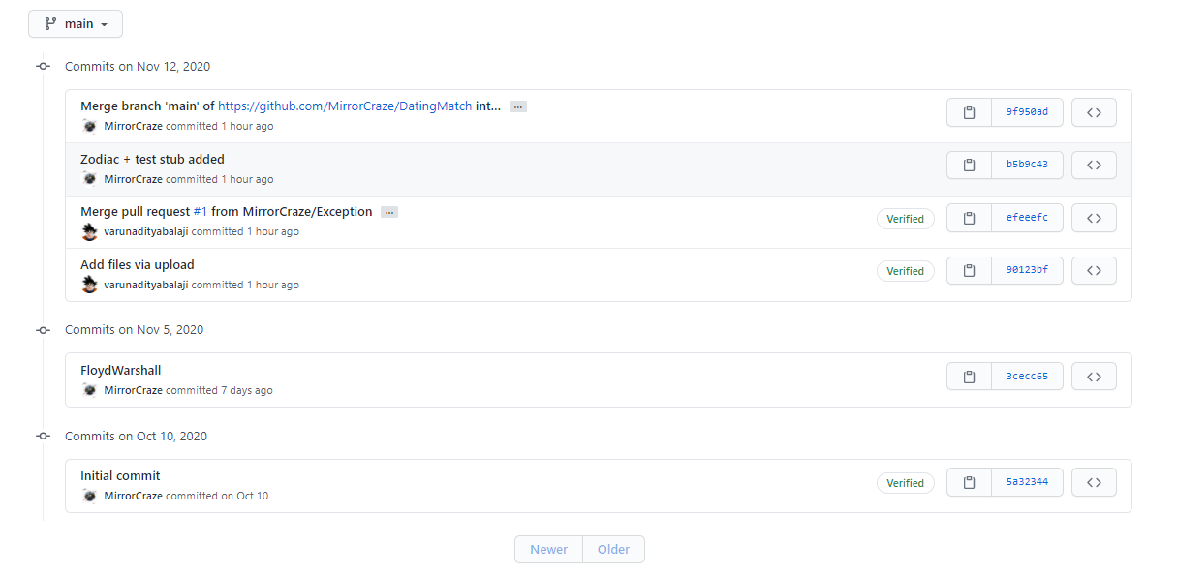
Version Control

Slide 16
The Vibing.com Software

Slide 17
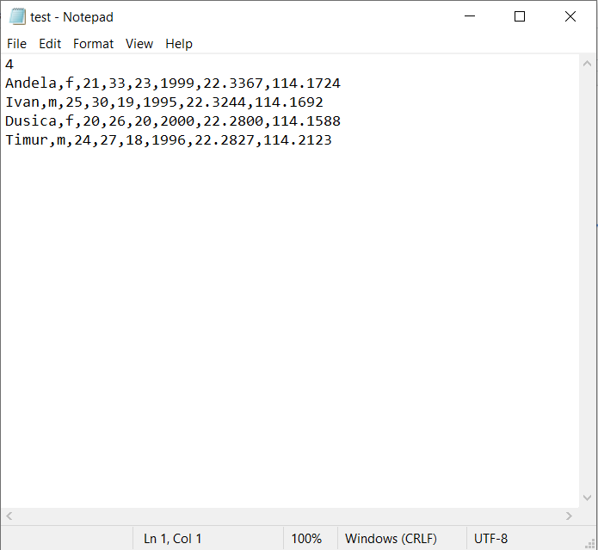
INPUT
The input is .txt file containing the finite number of lines, each one corresponding to one user.
The first line represents the total number of users at a time.
The input format is as follows:
Name, Gender (f/m), Age, Upper Age Boundary, Lower Age Boundary, Year of Birth, Latitude, Longitude
example

Slide 18
Functionalities
www.vibing.com
#1 calculates the shortest distances from you to all your potential partners along the following path:
Your home -> Start MTR station ->End MTR Station ->Partner’s home
#2 calculates the score u1.calculateScore(u2) that u2 scores for u1 based on the following formula:
totalScore=ageScore+locationScore+zodiacScore
#3 The main focus of our project is to find the most suitable partner for each user based on the scoring system

Slide 19
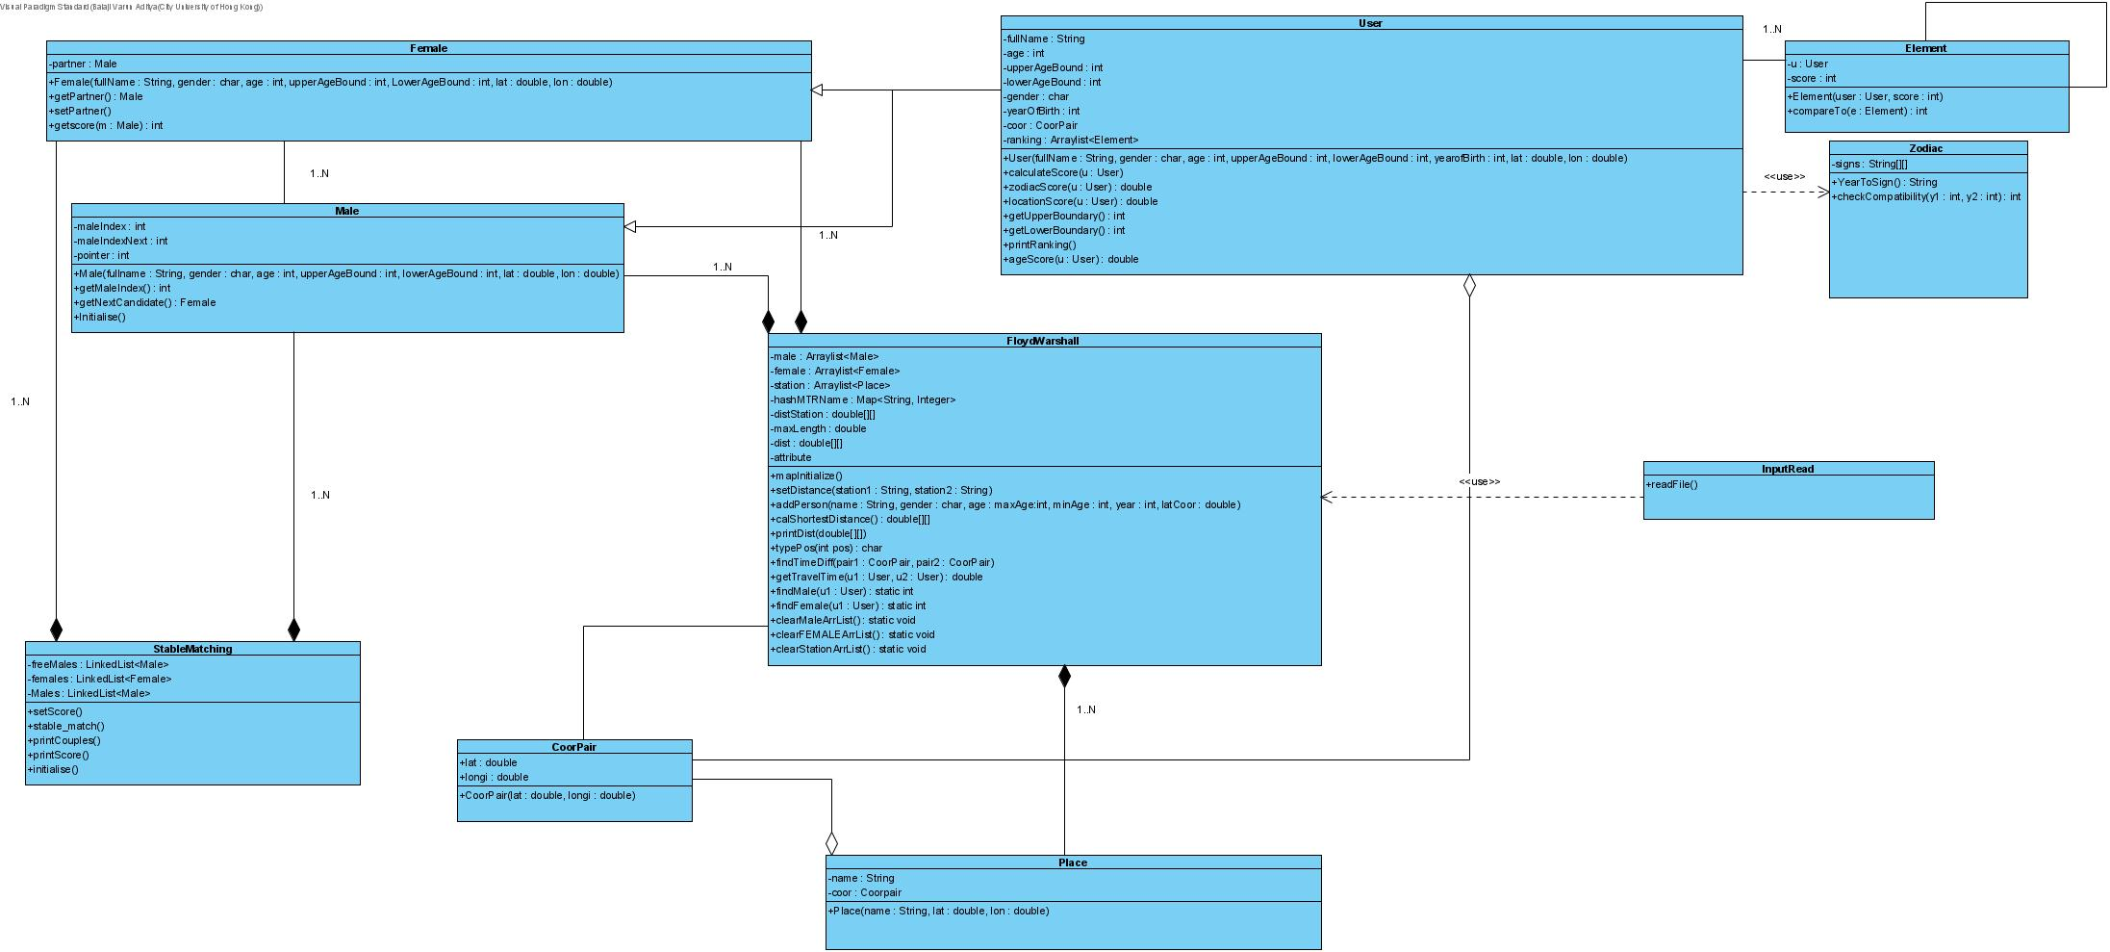
Class Diagram

Slide 20
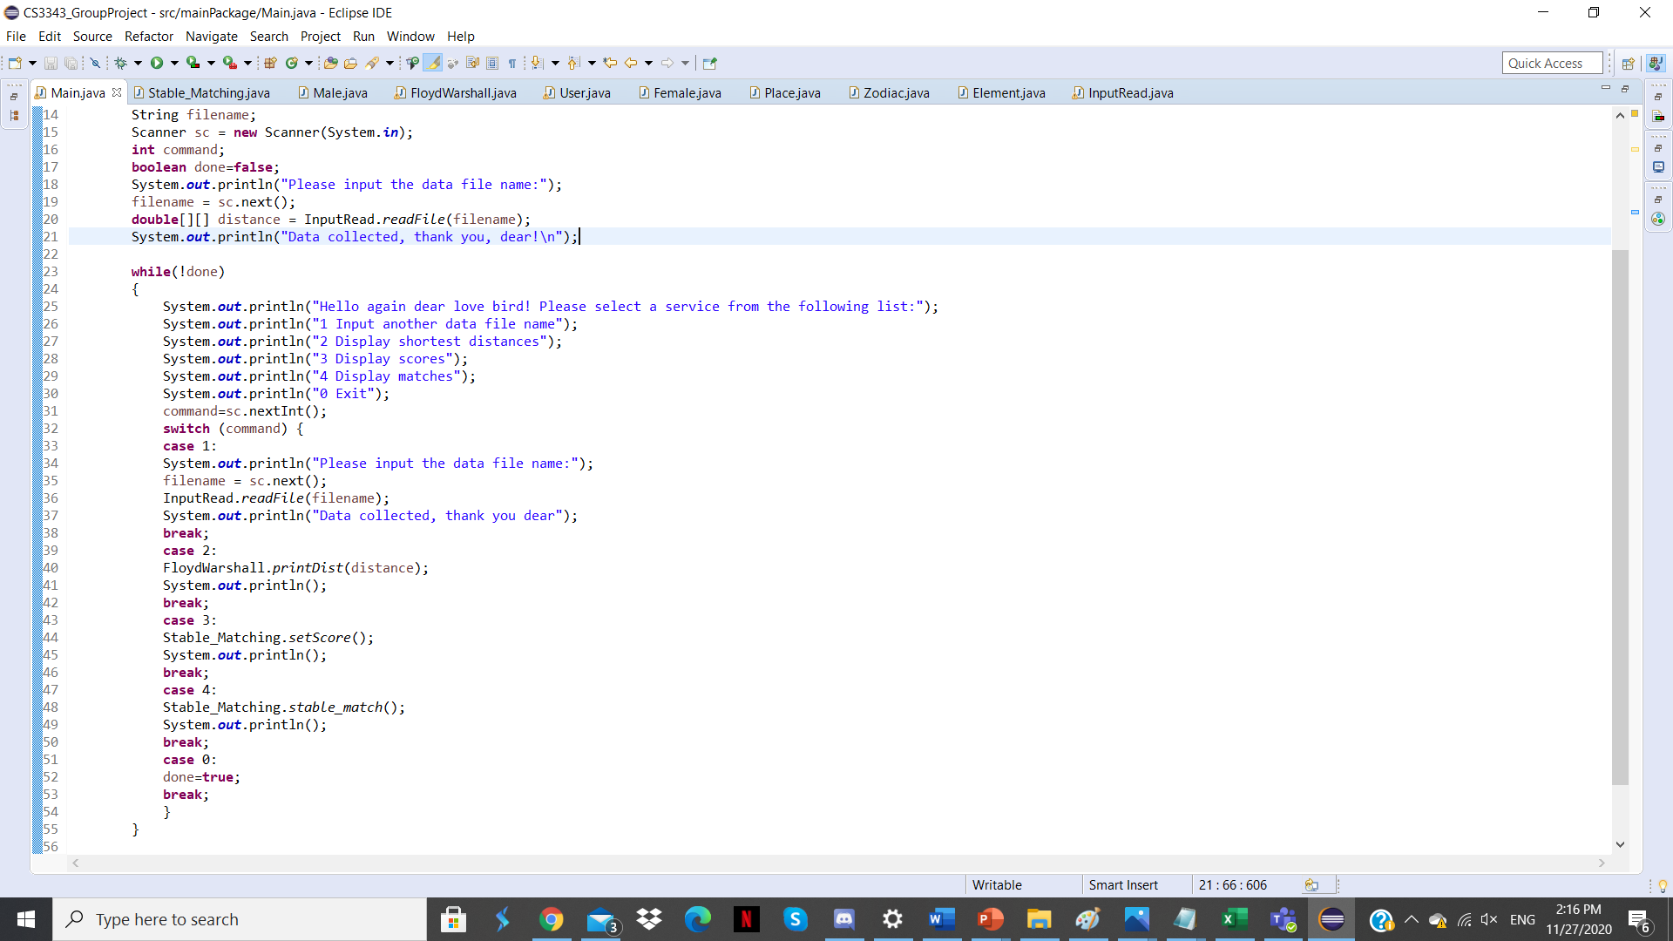
#MAIN

Slide 21
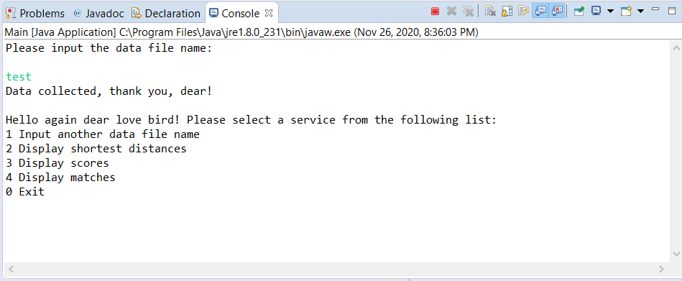
PROGRAM FLOW
The user is given 3 service options and required to choose among them.
The program loops until he/she selects 0 to exit and terminate it.

Slide 22
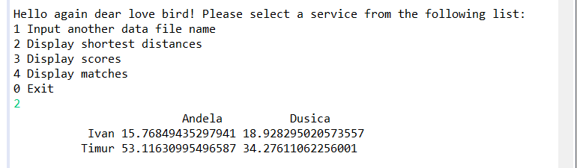
#2 Display shortest distance
The function distance=FloydWarshall.calShortestDist()
calculates the shortest distance between any two potential partners along the following path:
Home 1-> Start MTR station ->End MTR Station -> Home 2
The function FloydWarshall.printDist(distance)
prints the corresponding shortest distances.

Slide 23
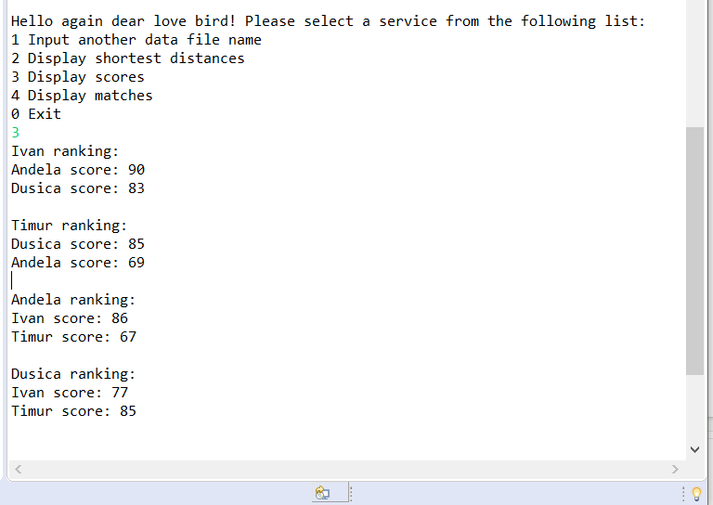
#3 Display scores
The function Stable_Matching.setScore();
calculates and prints the rankings for each user, in descending order

Slide 24
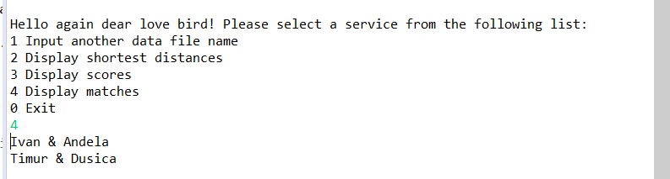
#4 Display matches
The function Stable_Matching.stable_match();
Utilizes the Stable Matching Algorithm to calculate the best matches and prints the most suitable partners based on the result

Slide 25
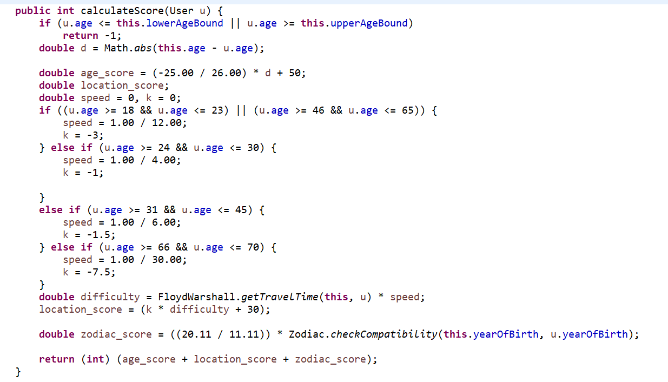
Code Refactoring
#1 Problem
One large method calculating the score of compatibility
Very long computation in one same function
Three responsibilities inside single function

Slide 26
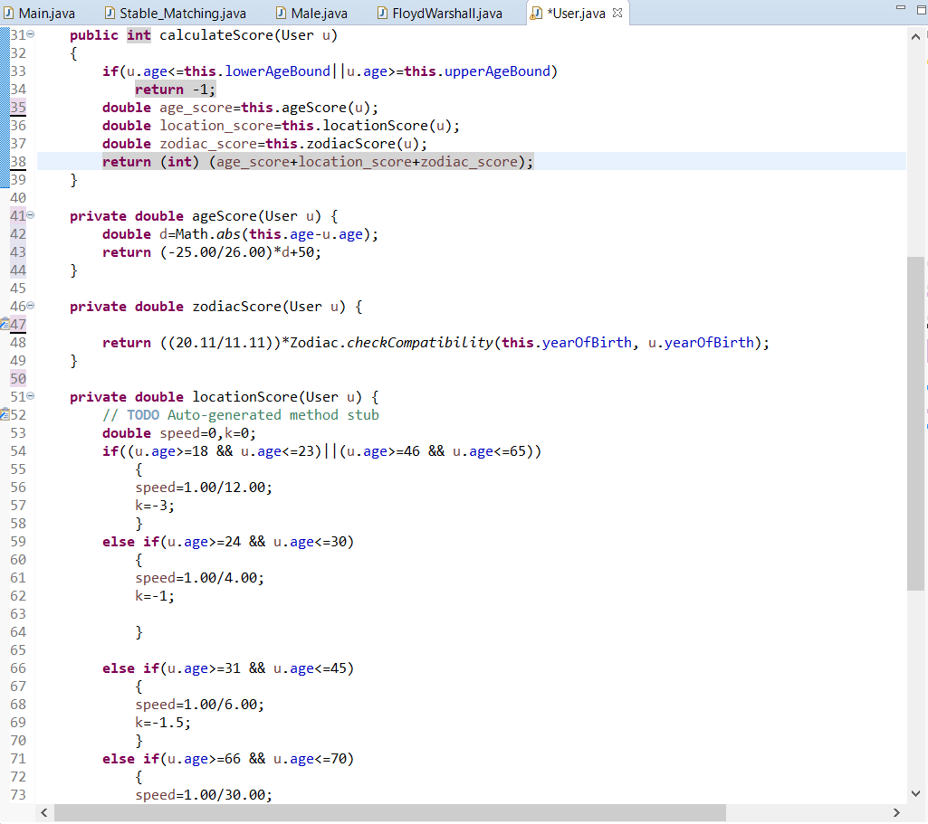
Solution #1
to this problem is to separate different responsibilities to different methods -
Extract Method Approach

Slide 27
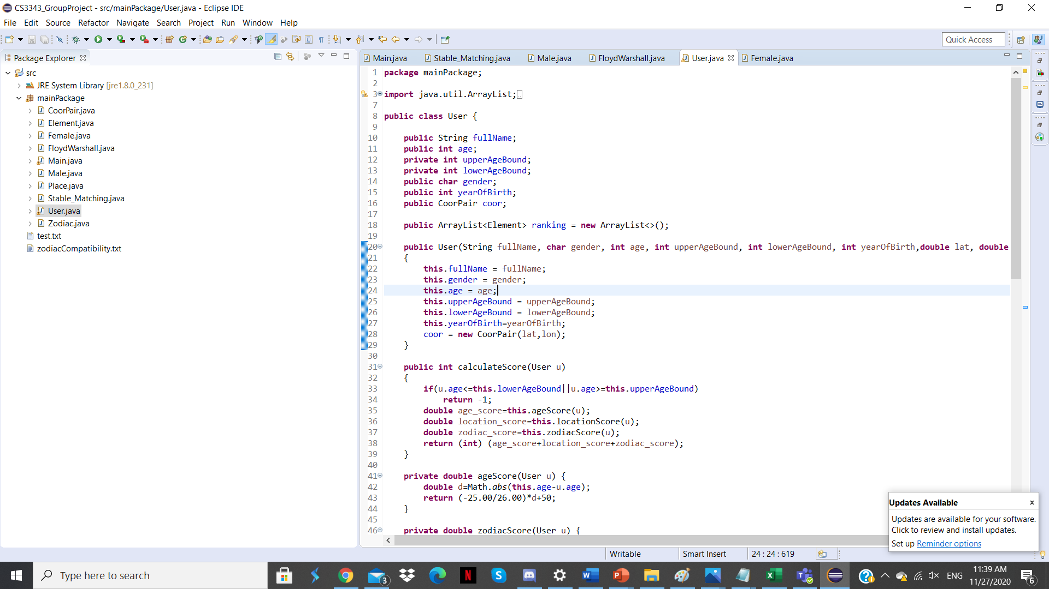
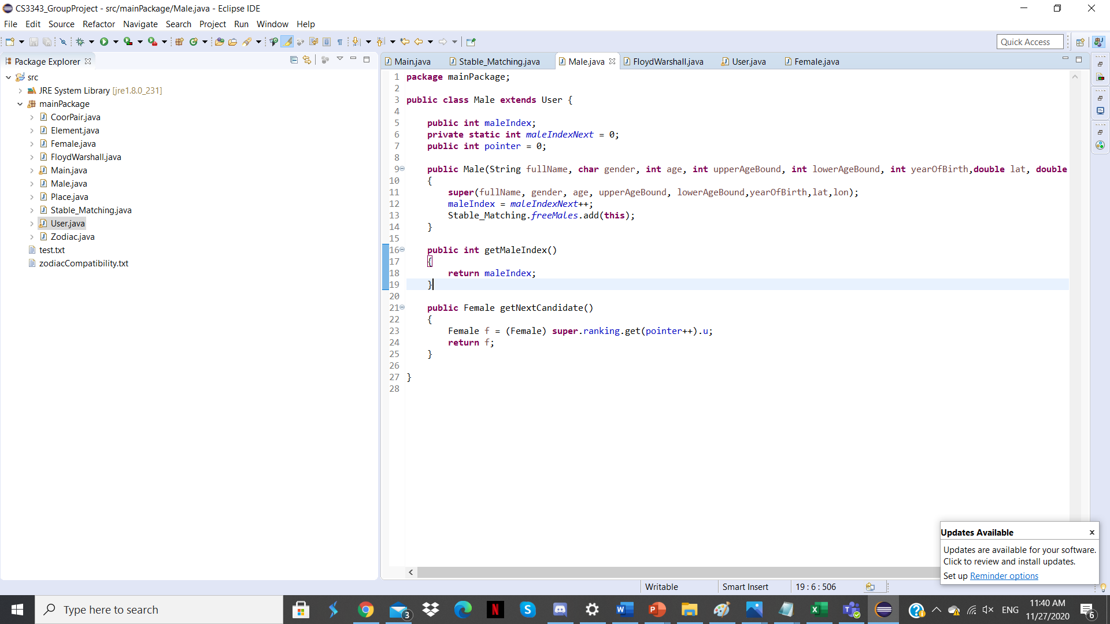
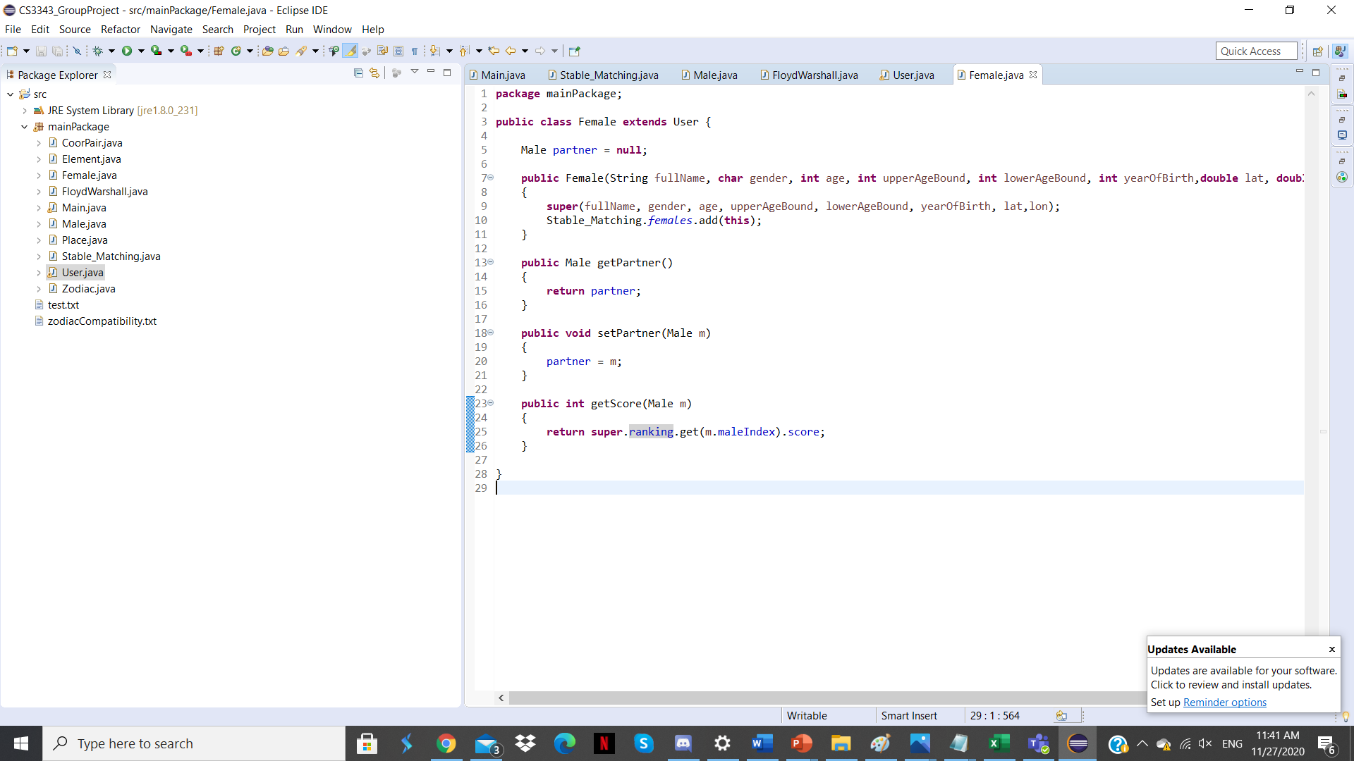
Code Refactoring
Problem #2 and Solution #2
Classes Male and Female have same fields: Name, Age, Year of Birth, etc…
Pull Up Field Approach -
Move the field up to the superclass User

Slide 28
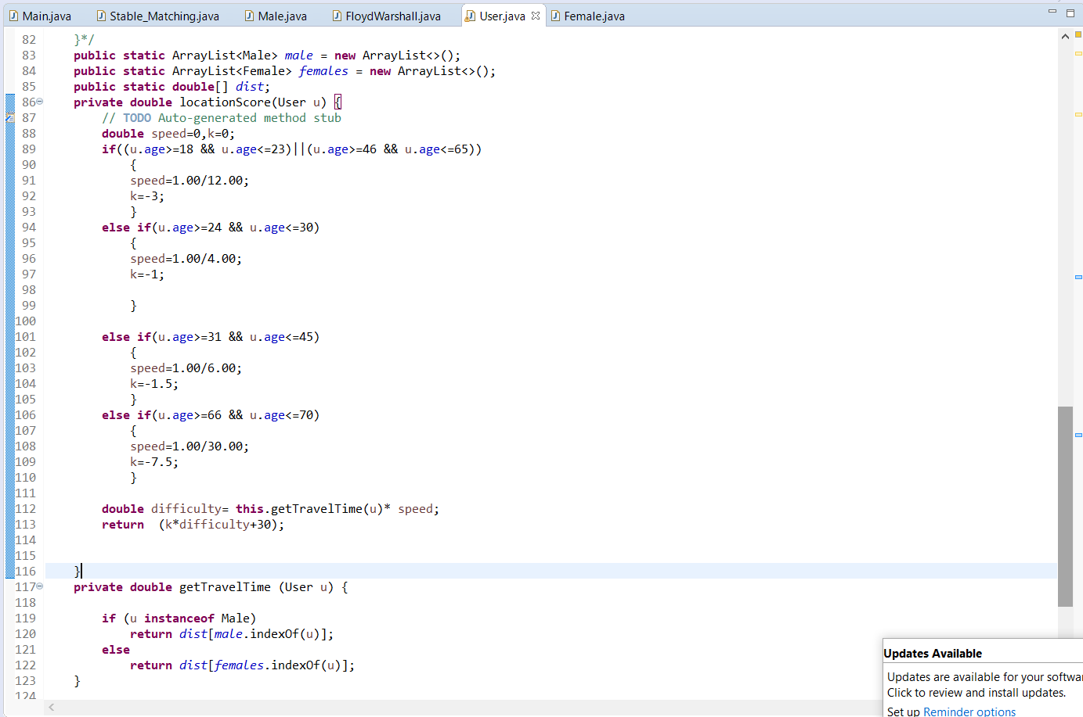
Code Refactoring
Problem #3
One large class - User - responsible for both the score calculation and travel time calculation (MTR Map)
Class User is responsible for the computations which should be done by separated class

Slide 29
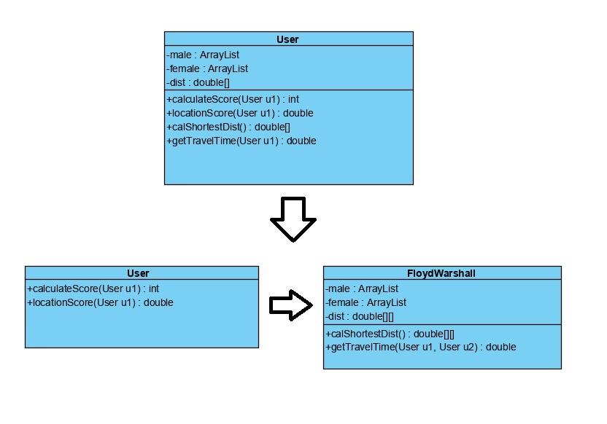
Solution #3
The class User has multiple responsibilities which are unrelated to its original purpose -
Class Extract Method
Relevant fields and methods are moved to FloydWarshall class

Slide 30
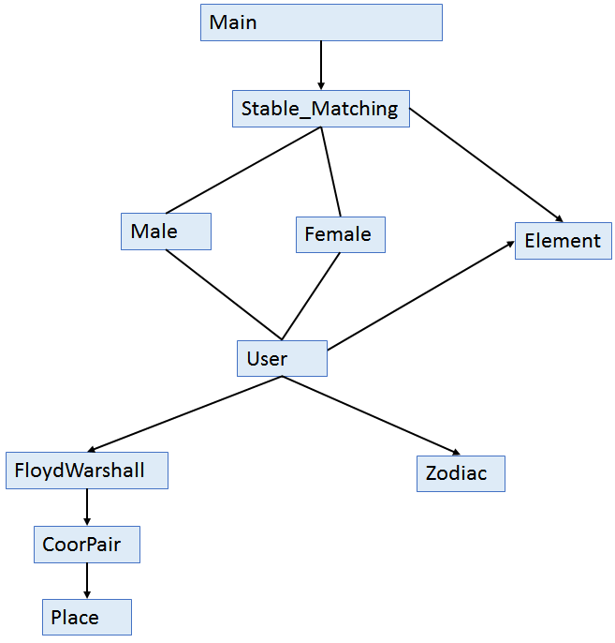
Program Hierarchy
Adopted method: Bottom-up approach
Unit Testing:
FloydWarshall (Test Stub: N/A)
Zodiac (Test Stub: N/A)
Element (Test Stub N/A)
Integration Testing:
User+FloydWarshall+Zodiac+Element(Test Stub: N/A)
Stable_Matching+User+FloydWarshall+Zodiac+Element (test Stub: N/A)
System Testing:
Main+Stable_Matching+User+FloydWarshall+Zodiac+Element (test Stub: N/A)

Slide 31
Testing

Slide 32
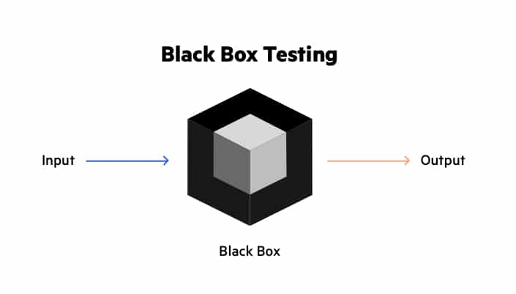
Black Box Testing
We calculated the size of the “universe” of possible test cases and started to plan the testing
We generated the possible test cases based on specification referencing the Statistical Testing Approach
Category-Partitioning Testing

Slide 33
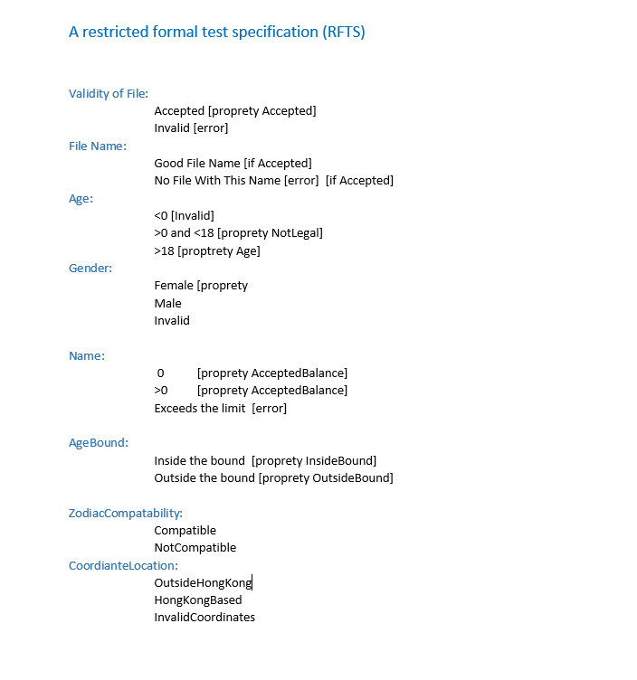
RFTS
Based on the specification
we set up on the first meeting

Slide 34
White Box Testing
Unit Testing and Integration Testing

Slide 35
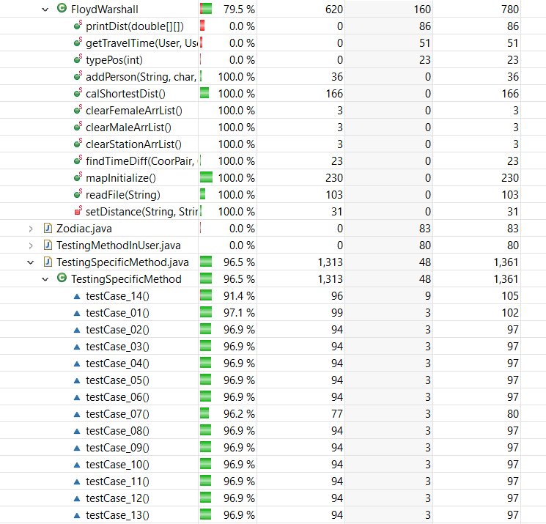
#1 Unit Testing - FloydWarshall
Testing is performed on the method calShortestDist()
which calculates the shortest distance between any two users

Slide 36
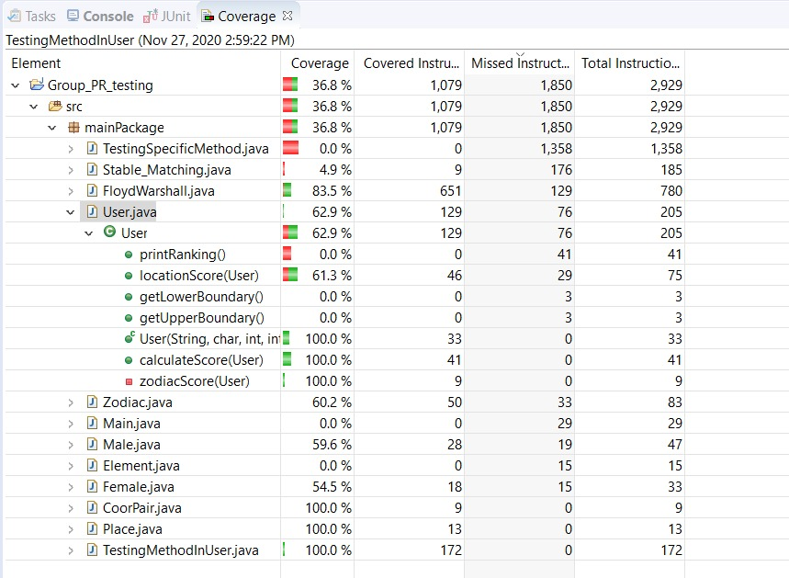
#1 Integration Testing - User
Testing is performed on the method
u1.calculateScore(u2)
which calculates the score which u2 scores for u1

Slide 37
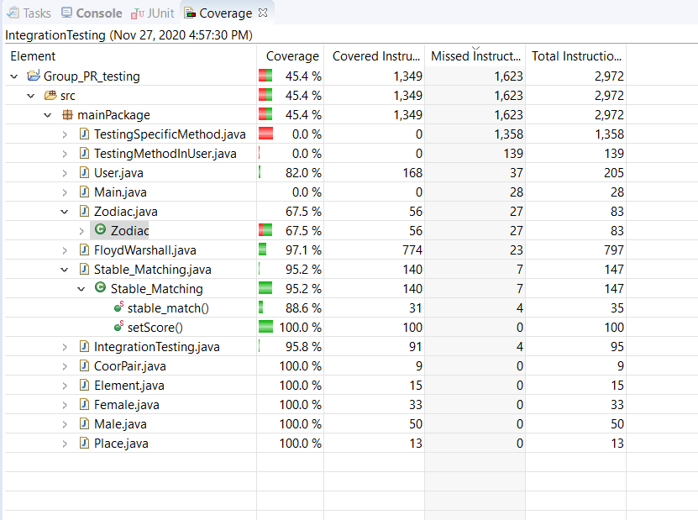
#2 Integration Testing - Stable_Matching
Testing is performed on the method
stable_match()
which performs the Stable Matching Algorithm and finds the best matches

Slide 38
Bug Report

Slide 39
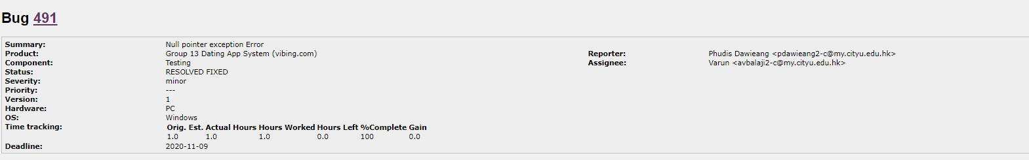
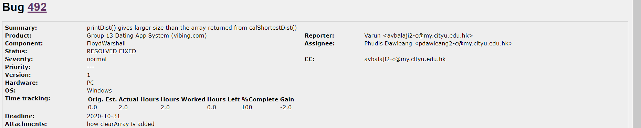
Bug Reports

Slide 40
Questions ?

